Slide 1
Communication and the Teen Brain
Garron Griffitts, LCSW

Slide 2
A great resource for all parents of Teens!
Communication and the Teen Brain

Slide 3
Parent Survival Kit
Communication and the Teen Brain
I am a good listener.
I can tolerate some adolescent “attitude.”
I am able to avoid power struggles with my teenager.
I am able to remain calm even when my teen doesn’t.
I understand the brain’s role in teen communication.

Slide 4
Parent Survival Kit
Communication and the Teen Brain
I can avoid generalizations when talking to my teen.
When communication becomes tense I can stay focused on one issue at a time.
I never engage in name-calling or put-downs when talking to my teenager.
I never swear or use foul language toward my teen or other people.
I do not accept foul or abusive language from my teen.

Slide 5
Limbic System in full force
3 Major challenges Teens have with communication
The amygdala reacts first and asks questions later

Slide 6
Misread emotions
3 Major challenges Teens have with communication
Teens use the amygdala of the brain to read emotions -
This is where fear and anger originate
While adults use the PFC
This is the rational part of the brain
Anger

Slide 7
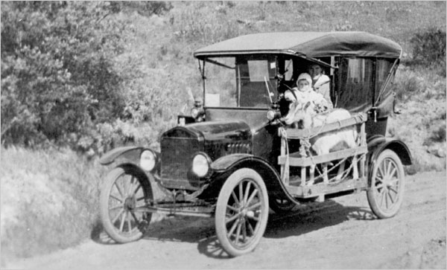
Brakes are on back order
3 Major challenges Teens have with communication
The Prefrontal Cortex is not opener business

Slide 8
Gut Response
+
Misinterpretation
+
Lousy Brakes
=
Poor Communication

Slide 9
STRONG DON’TS
Communication and the Teen Brain
Don’t swear or use abusive language
Don’t accept swearing or abusive language from them
Don’t get caught up in a yelling match
Don’t name call, criticize or put down
Don’t leave conflict unresolved

Slide 10
What parents can do
Communication and the Teen Brain
Keep Calm - Model effective communication skills
Clearly state your feelings
Educate teen on their own brain (Not during an argument)
When you slip, apologize
Listen, Listen, Listen

Slide 11
What parents can do
Communication and the Teen Brain
Let them know you understand where they are coming from - Never say you understand what they are going through - YOU PROBABLY DON’T!
Validate their thoughts and emotions
Expect and tolerate a little attitude
Walk away or let them walk away if necessary
Assure them that you love them

